Slide 1

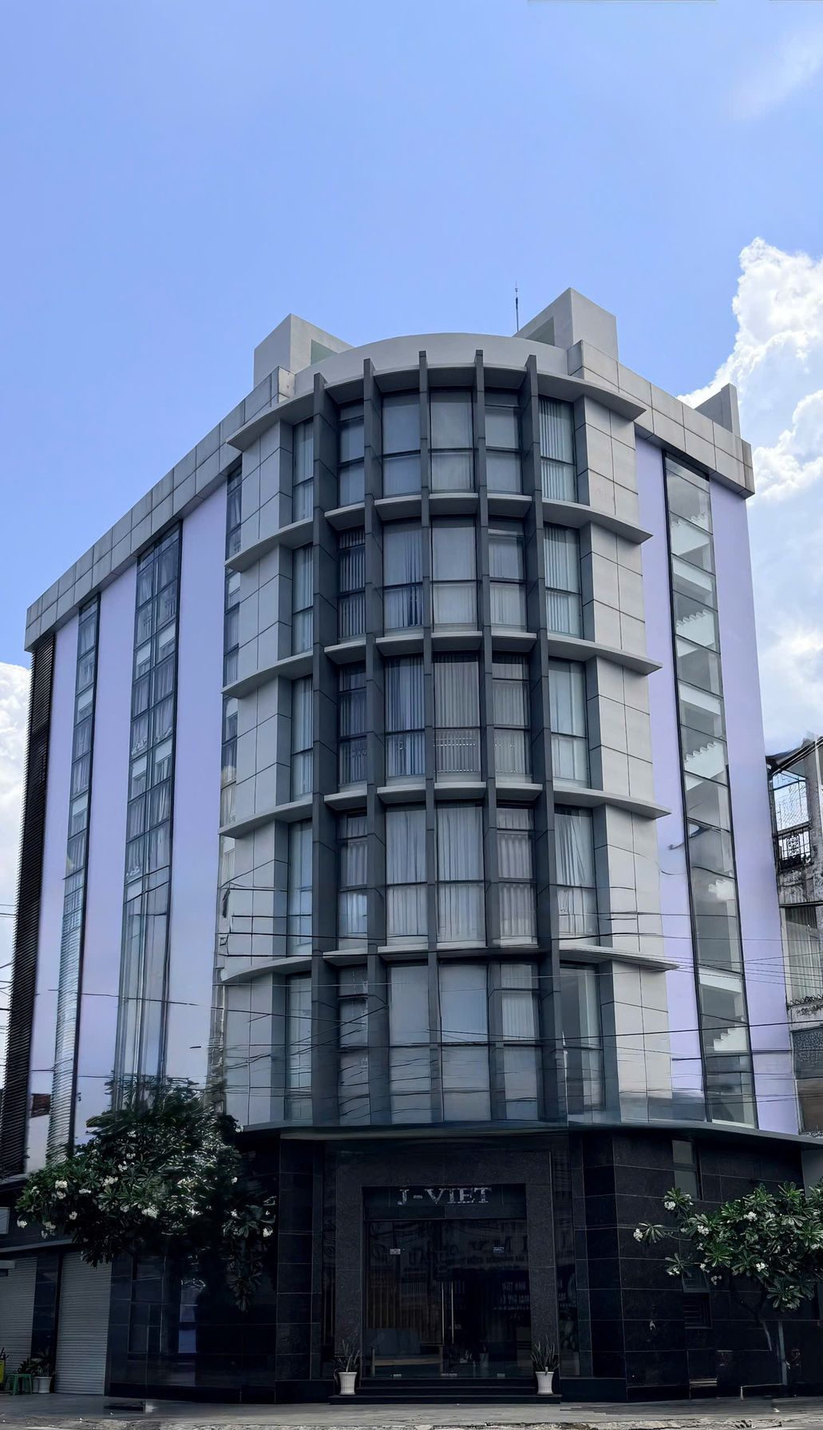
J-VIET J.S.C
PROFILE
Land lot No. 1642 – 1643, Map sheet No. 273, Viet Sing Settlement, An Phu Ward, Ho Chi Minh City, Vietnam
Quality
Cooperation
Development

Slide 2
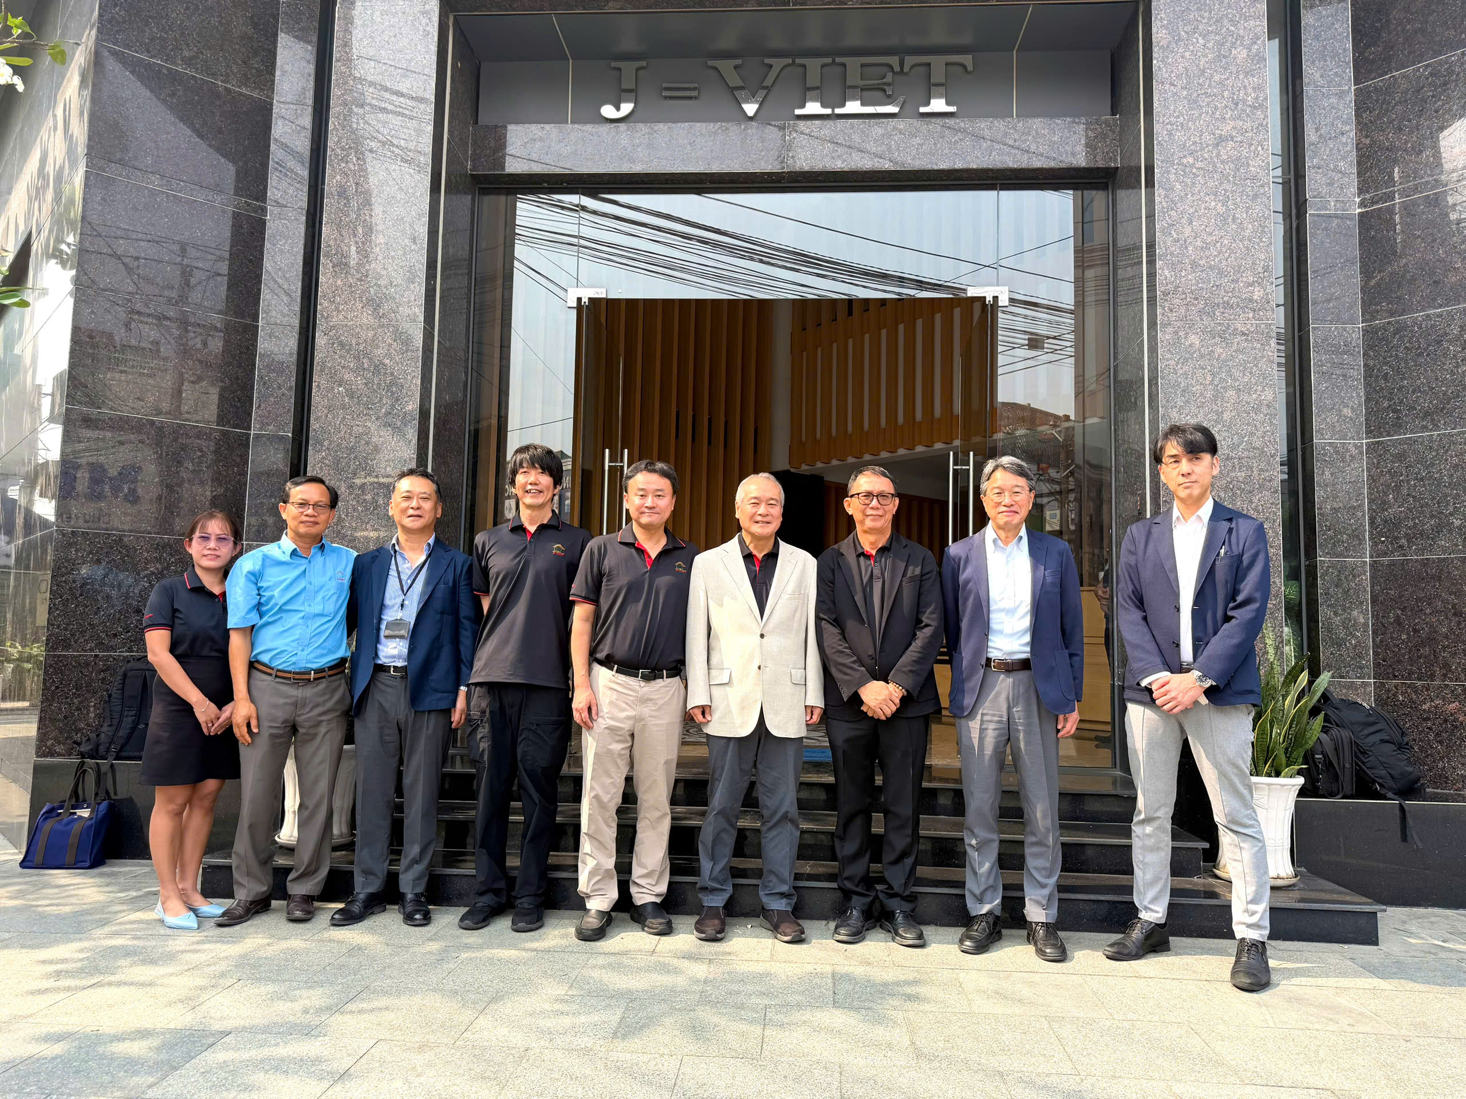
Overview
History & Development
Shareholders
Human Resources
Organization Chart
Team Responsibilities
Specialized Software
Work Volume
Office
Annual Activities

Slide 3
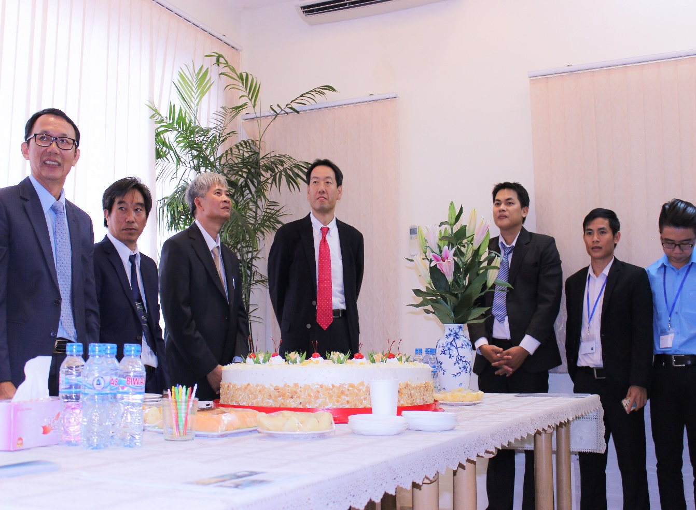
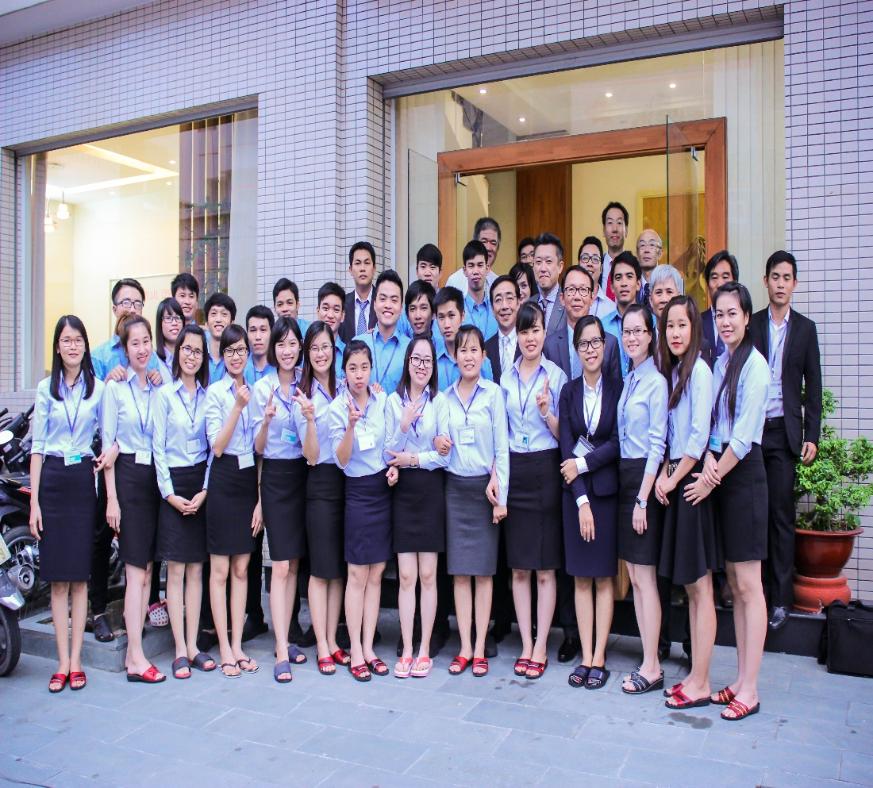
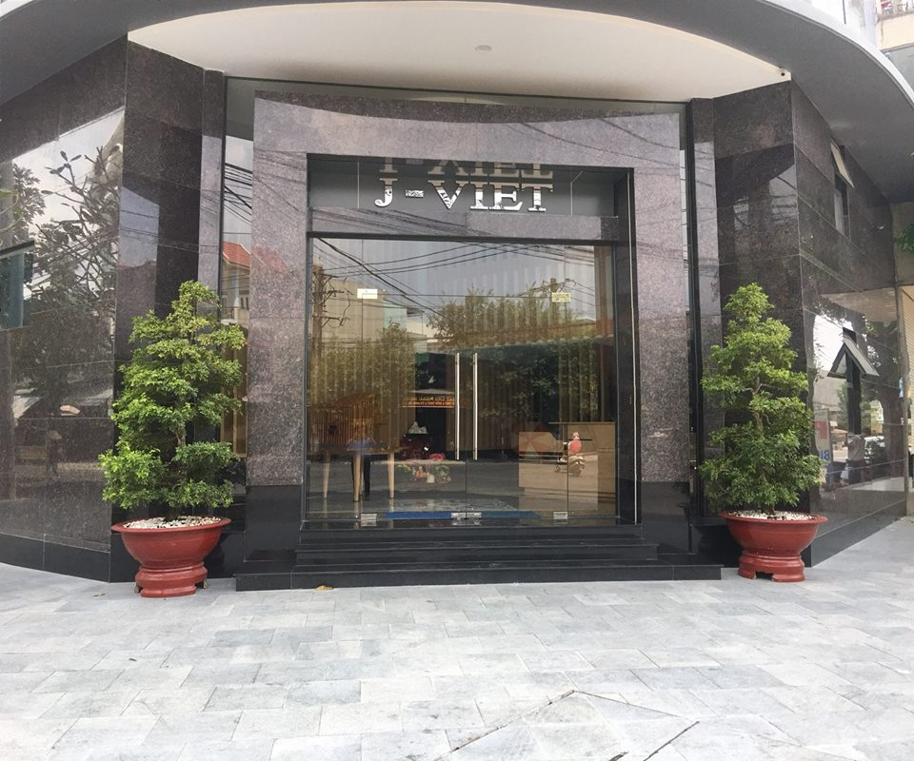
History & Development
10/2013 Representative office established
(former office at D1–D33 street).
04 /2014 S.E.V.E.N-VIET Engineering Joint
Stock Company established.
06/2017 J-VIET Joint Stock Company
established.
03/2019–Present: J-VIET Joint Stock
Company,
Head Office at D1–D35 street.

Slide 4



VIETWOOD INDUSTRIES J.S.C
SHAREHOLDERS
SEVEN INDUSTRIES CO., LTD
SMB KENZAI CO.,LTD

Slide 5
HUMAN RESOURCES
Current workforce:
86 employees.
Organization Chart

Slide 6

Organization Chart
ADMIN- ACCOUNT DEPT: 02 STAFFS
GMS
Mr. KOICHI KINOSHITA
Mr. NGUYEN VAN NGHE
Mr. YOSHIKI YAMAGUCHI
SUB LEADER
NGO HOANG HAI
CHIEF ACCOUNTANT
NGUYEN THI CAM LE
MANAGER 2
TO DUY PHUONG
LEADER
NGUYEN DUC LAM
SUB LEADER
LE DUY PHUC
TEAM A
21 STAFFS
BOM
Mr. KOICHI KINOSHITA
Mr. MASARU YOKOI
Mr. HIDEAKI OKUBO
Mr. WATARU KOGO
Mr. NGUYEN VAN NGHE
Mr. HUYNH VAN LANH
SUB LEADER
NGUYEN HOANG DUNG
SUB LEADER
PHAM XUAN THIEN
GM
Mr. MASARU YOKOI
SUB LEADER
NGUYEN NGOC THAO
LEADER
LY HA BAO NGAN
TEAM B
15 STAFFS
MANAGER 2
MAI VAN PHI
DGM
Mr. YOHEI KATO
Mr . MICHIHARU ABE
Ms. PHAM THI BICH LOAN
SUB LEADER
NGUYEN TRUONG SON
SUB LEADER
MAI GIAP TUNG
TEAM C
22 STAFFS
MANAGER 2
NGUYEN XUAN TANG
MANAGER 1
LE NHAT LINH
LEADER
NGUYEN BICH HOA
TEAM E
11 STAFFS

Slide 7
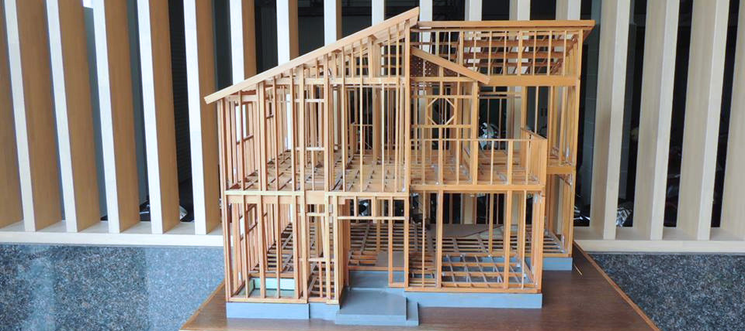
TEAM RESPONSIBILITIES
TEAM A
TEAM B
TEAM C
TEAM E
IPPAN (SIJISHO, TEISEI)
HAJIMEKEN (3F, SIJISHO)
INNOSHO (SIJISHO)
KATSURA
NS PANERU
ANESUTOWAN
ICHIMURA
NEDA
TOESIJISHO
TOESHOKI
IIDA
IIDA TEISEI
SIPOREX
TSUBOHIROI
KOZOKEISAN
SE RCC/SHISHO
SE IPPAN/MJJ
KOZO CHECK
ANKASEKISAN
SEVEN SE MITSUMORI
WOLF SAKUZU
WOLF KEISANJOKEN
FW IIDA
FW IIDA SIZISO
FW IIDA SIZISO 3F
FW IIDA CHECK
FW IIDA TEISEI
NIHON
SEVEN IIDA
SEVEN IIDA SIZISO
SEVEN IIDA７型入力
INNOSYO IIDA
INNOSYO IIDA SIZISO
INNOSYO IIDA SIZISO 3F
INNOSYO IIDA TEISEI
JIKKO YOSAN
IIDA SEKISAN
DATA ENTRY

Slide 8

SPECIALIZED SOFTWARE
◇TOACAD
◇ARCHITREND ZERO
◇NETEAGLECAD
◇TSUBOHIROI
◇HEIBE-KUN
◇SUPERSOFT
◇AUTOCAD
◇JWW CAD
◇業務課（WEB）

Slide 9
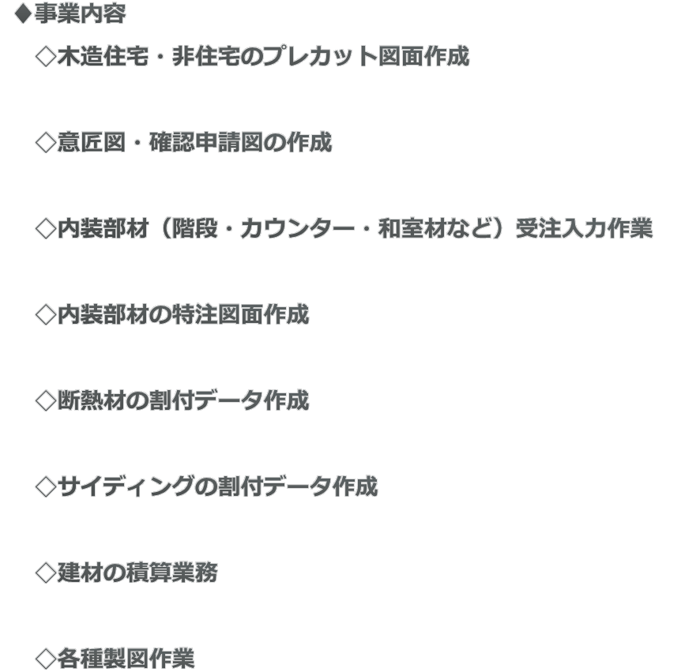
CAD DESIGN

Slide 10
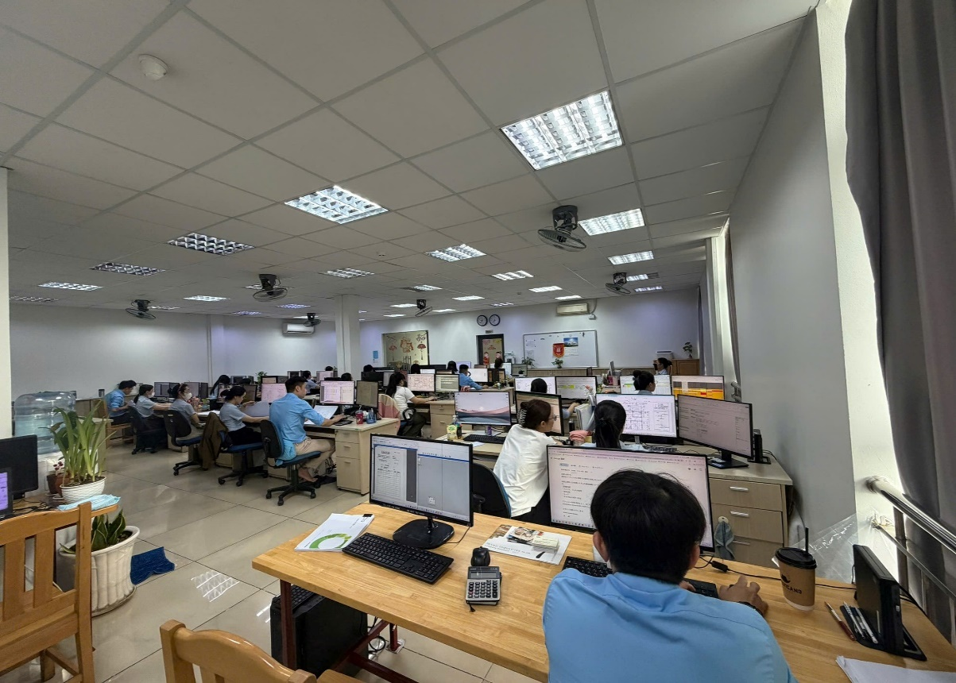
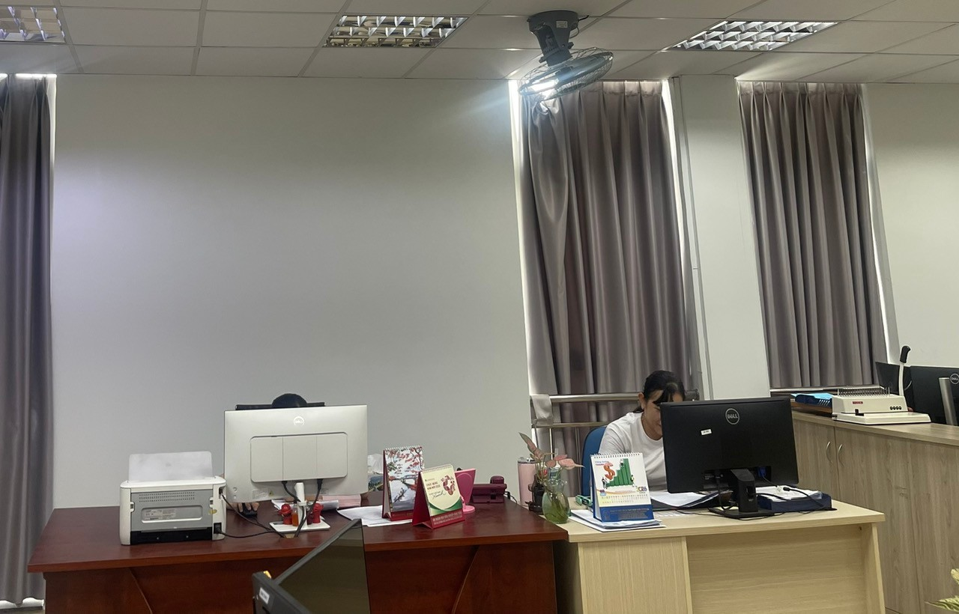
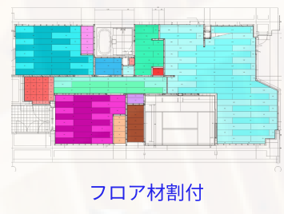
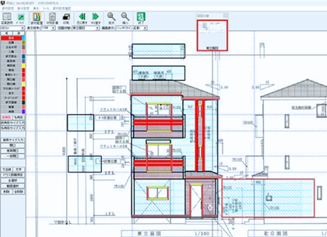
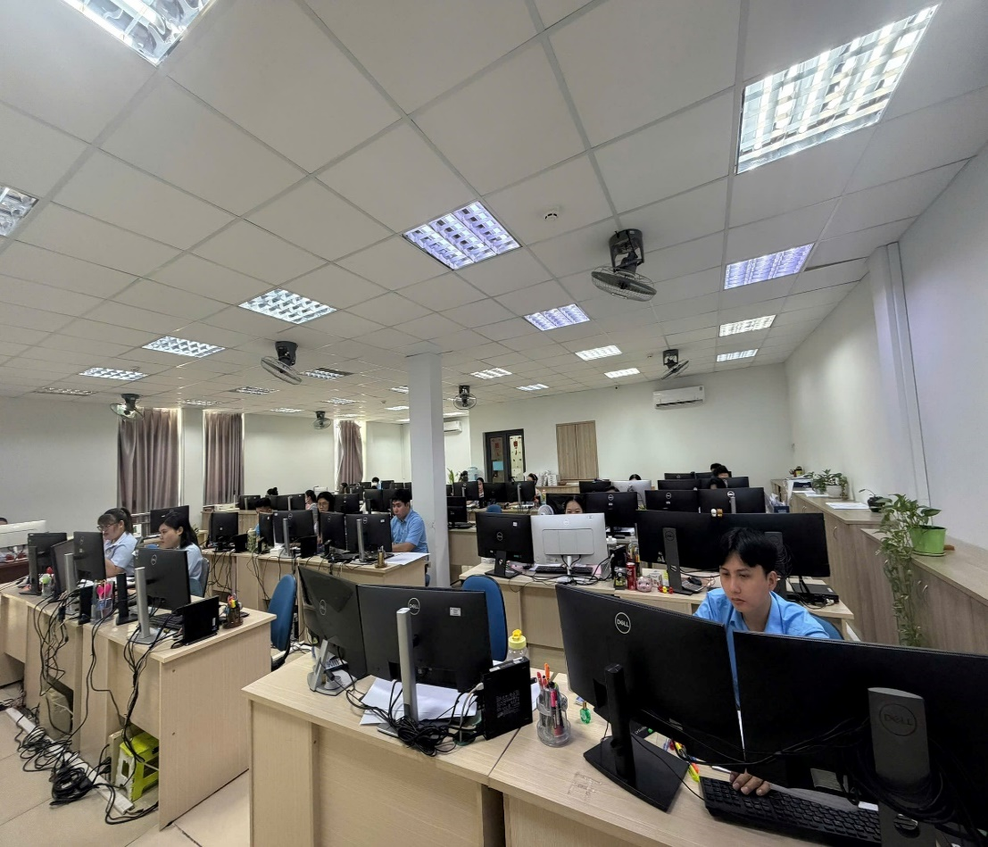
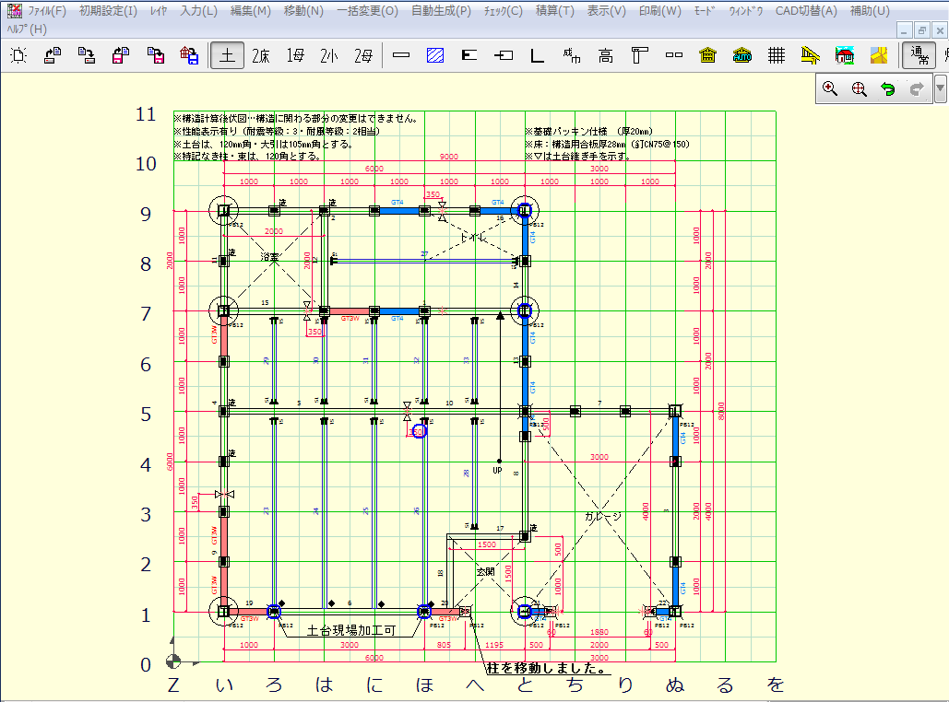
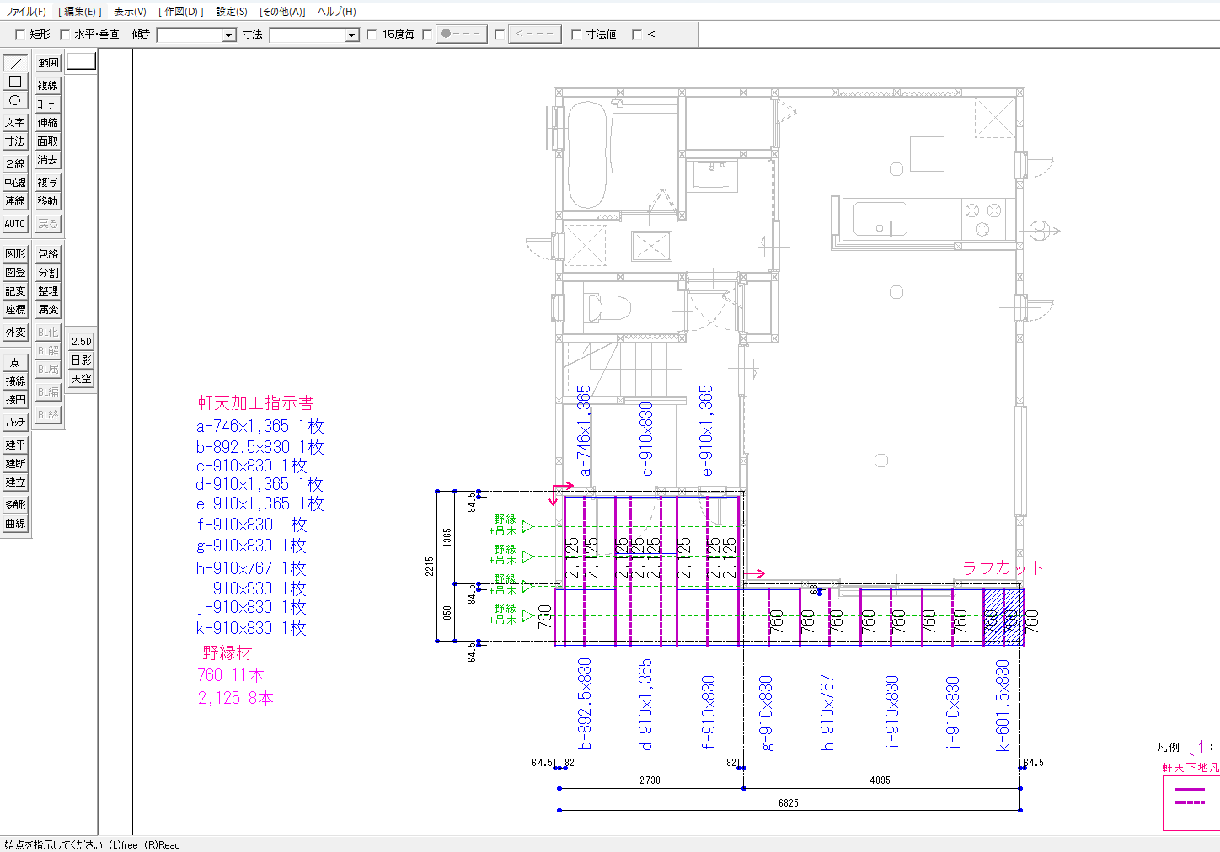
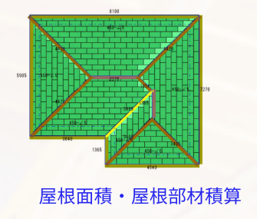
4TH FLOOR
ADMIN - ACCOUNTING - TEAM C
TSUBOHIROI
ADMIN- ACCOUNTING
NETEAGLECAD
JWW CAD

Slide 11
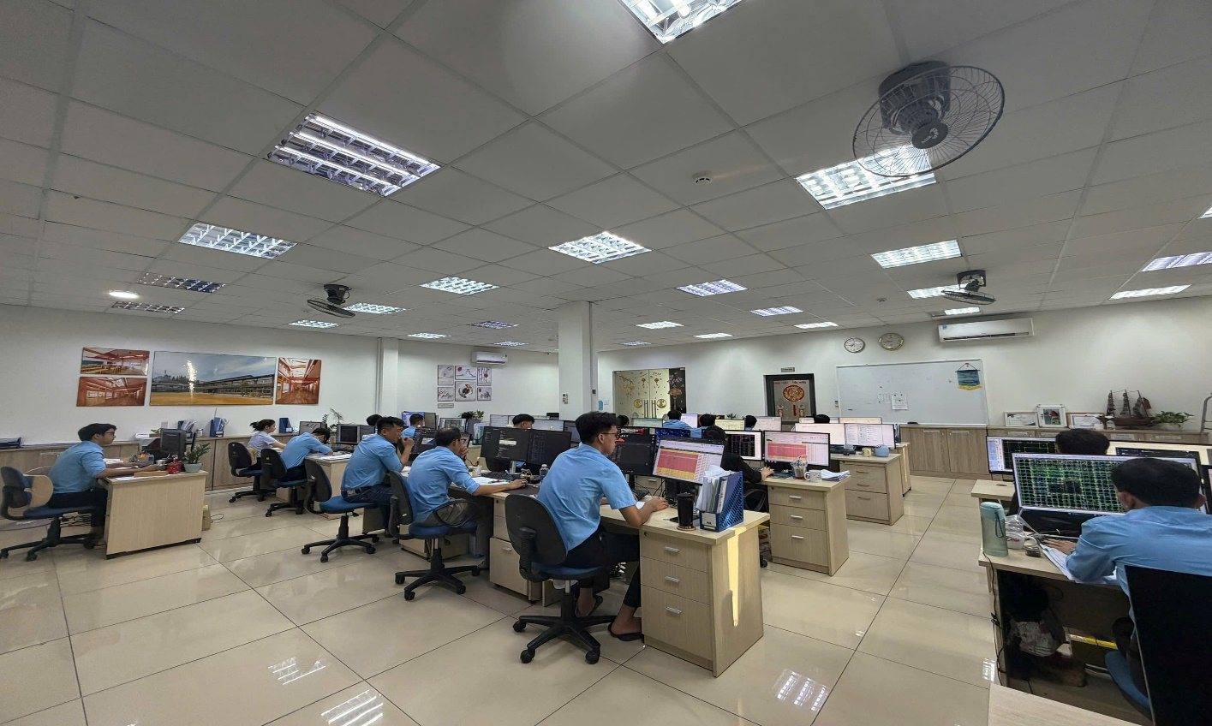
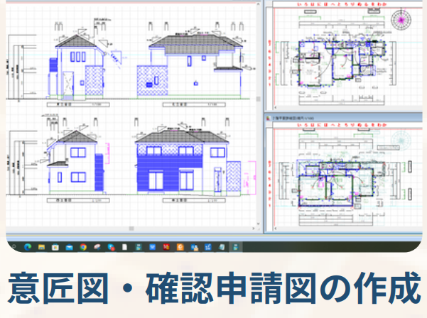
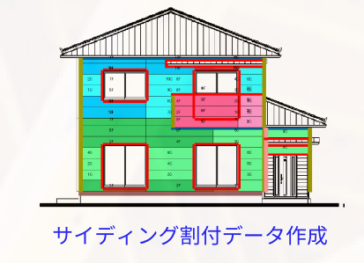
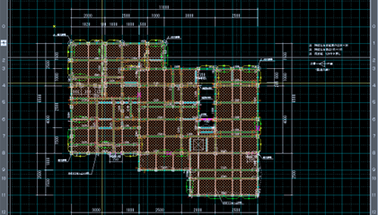
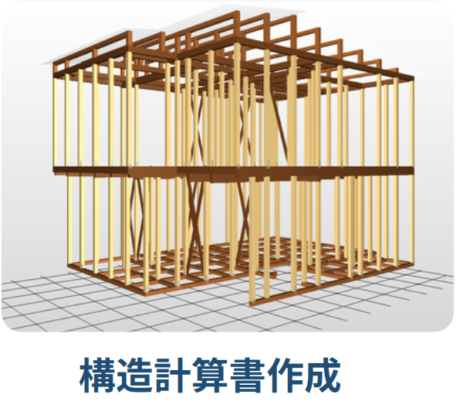
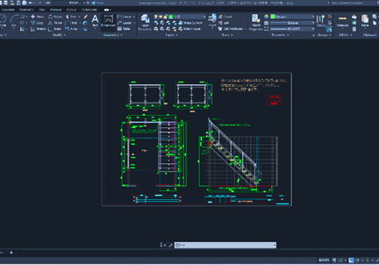
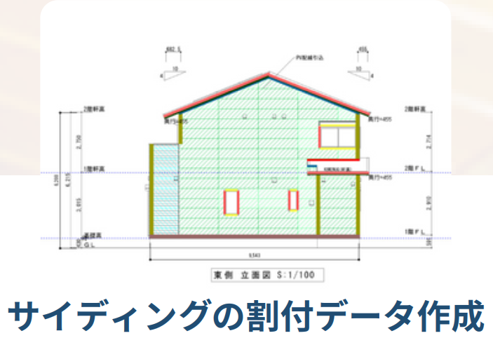
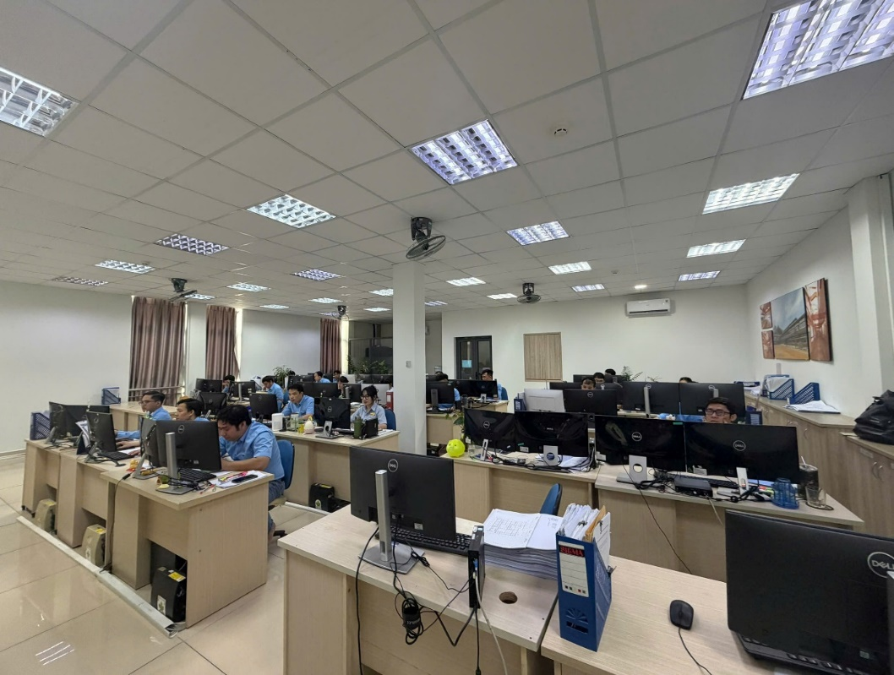
3RD FLOOR
TEAM A
TOACAD
ARCHITREND ZERO

Slide 12
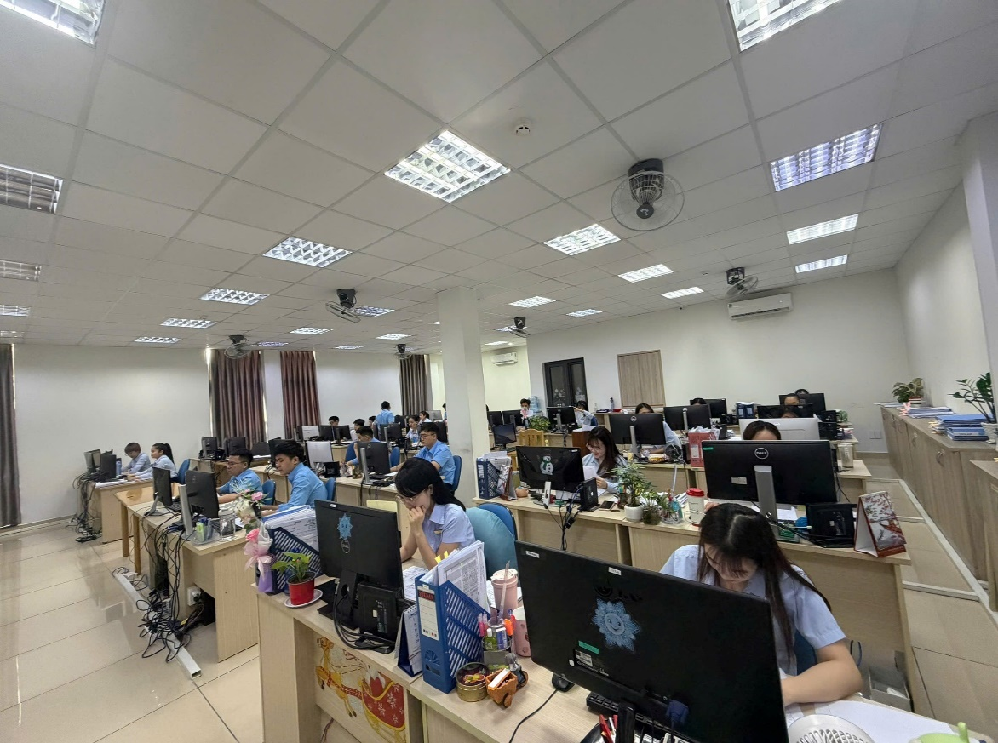
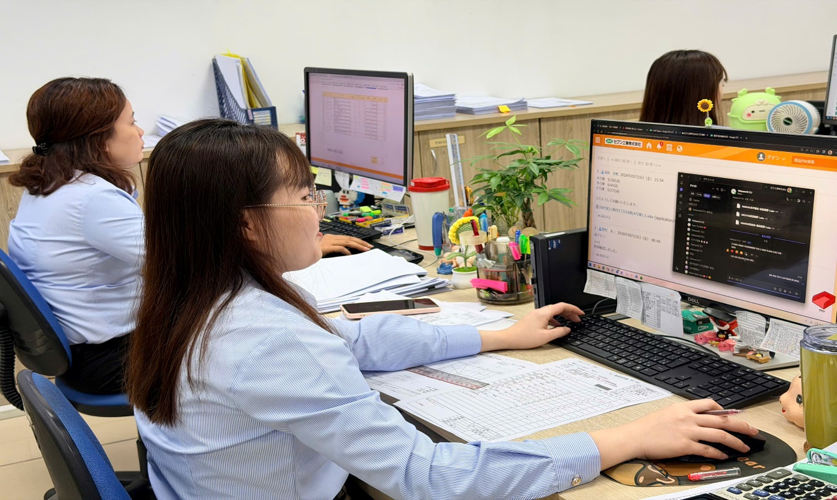
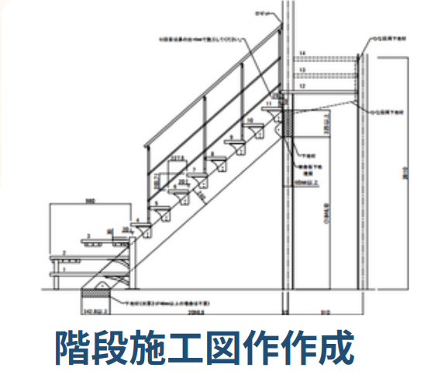
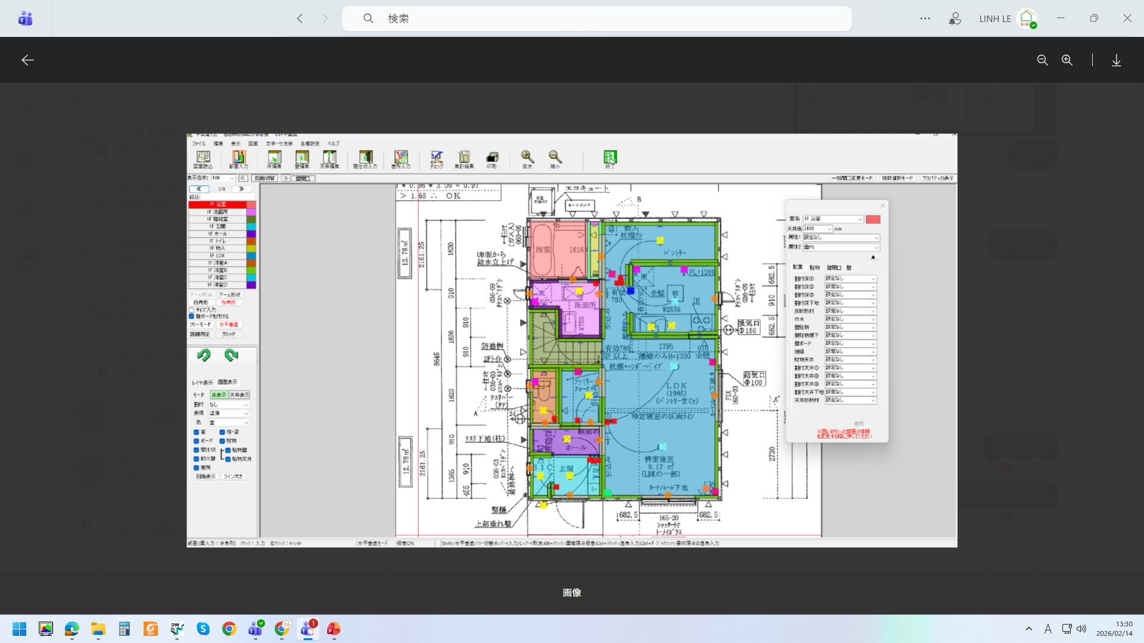
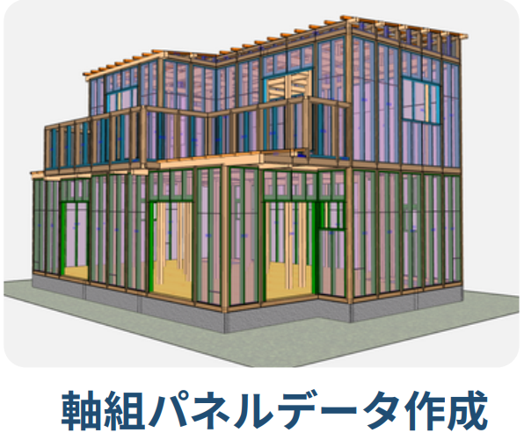
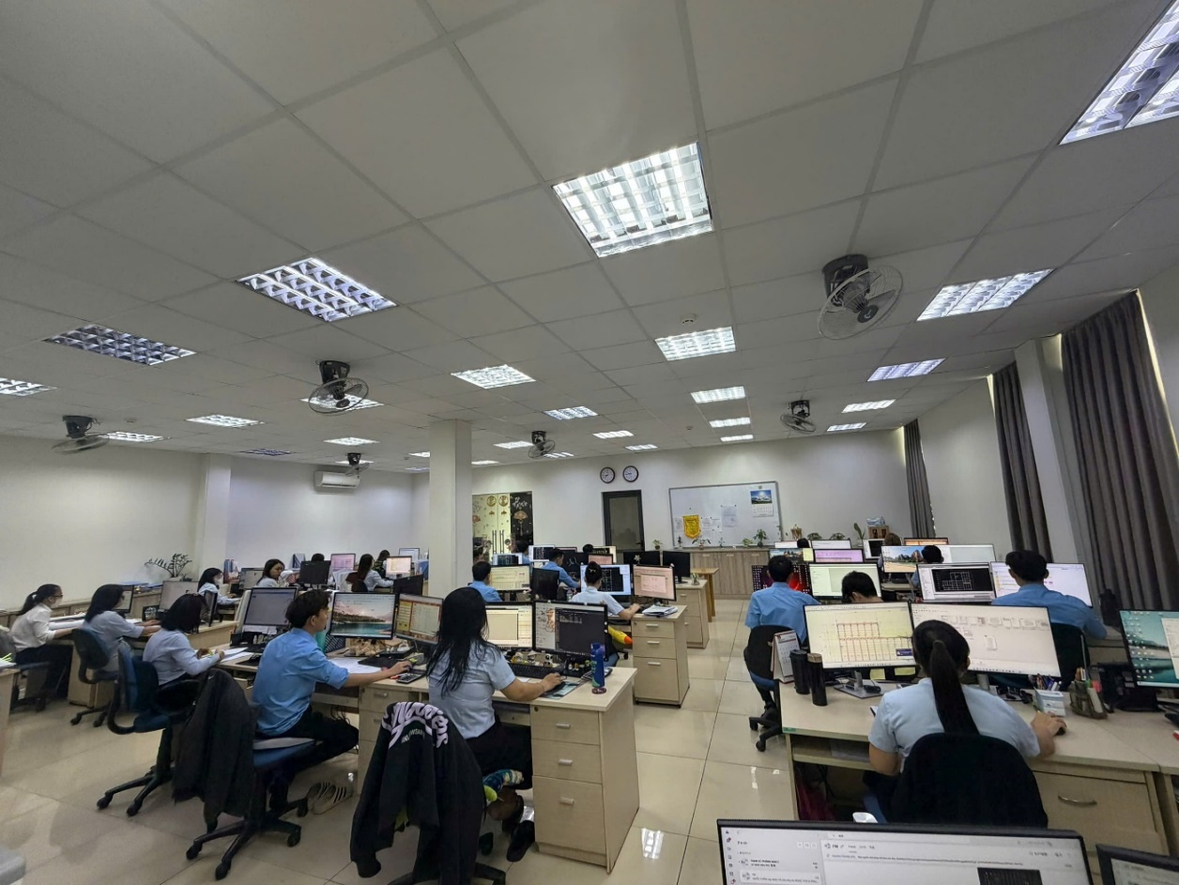
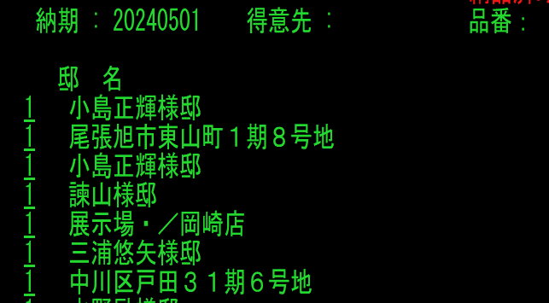
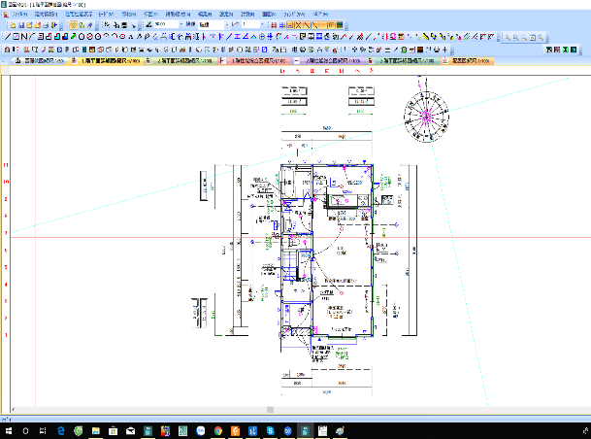
2ND FLOOR
TEAM B – TEAM E
HEIBE-KUN
SUPERSOFT
NHẬP LIỆU

Slide 13
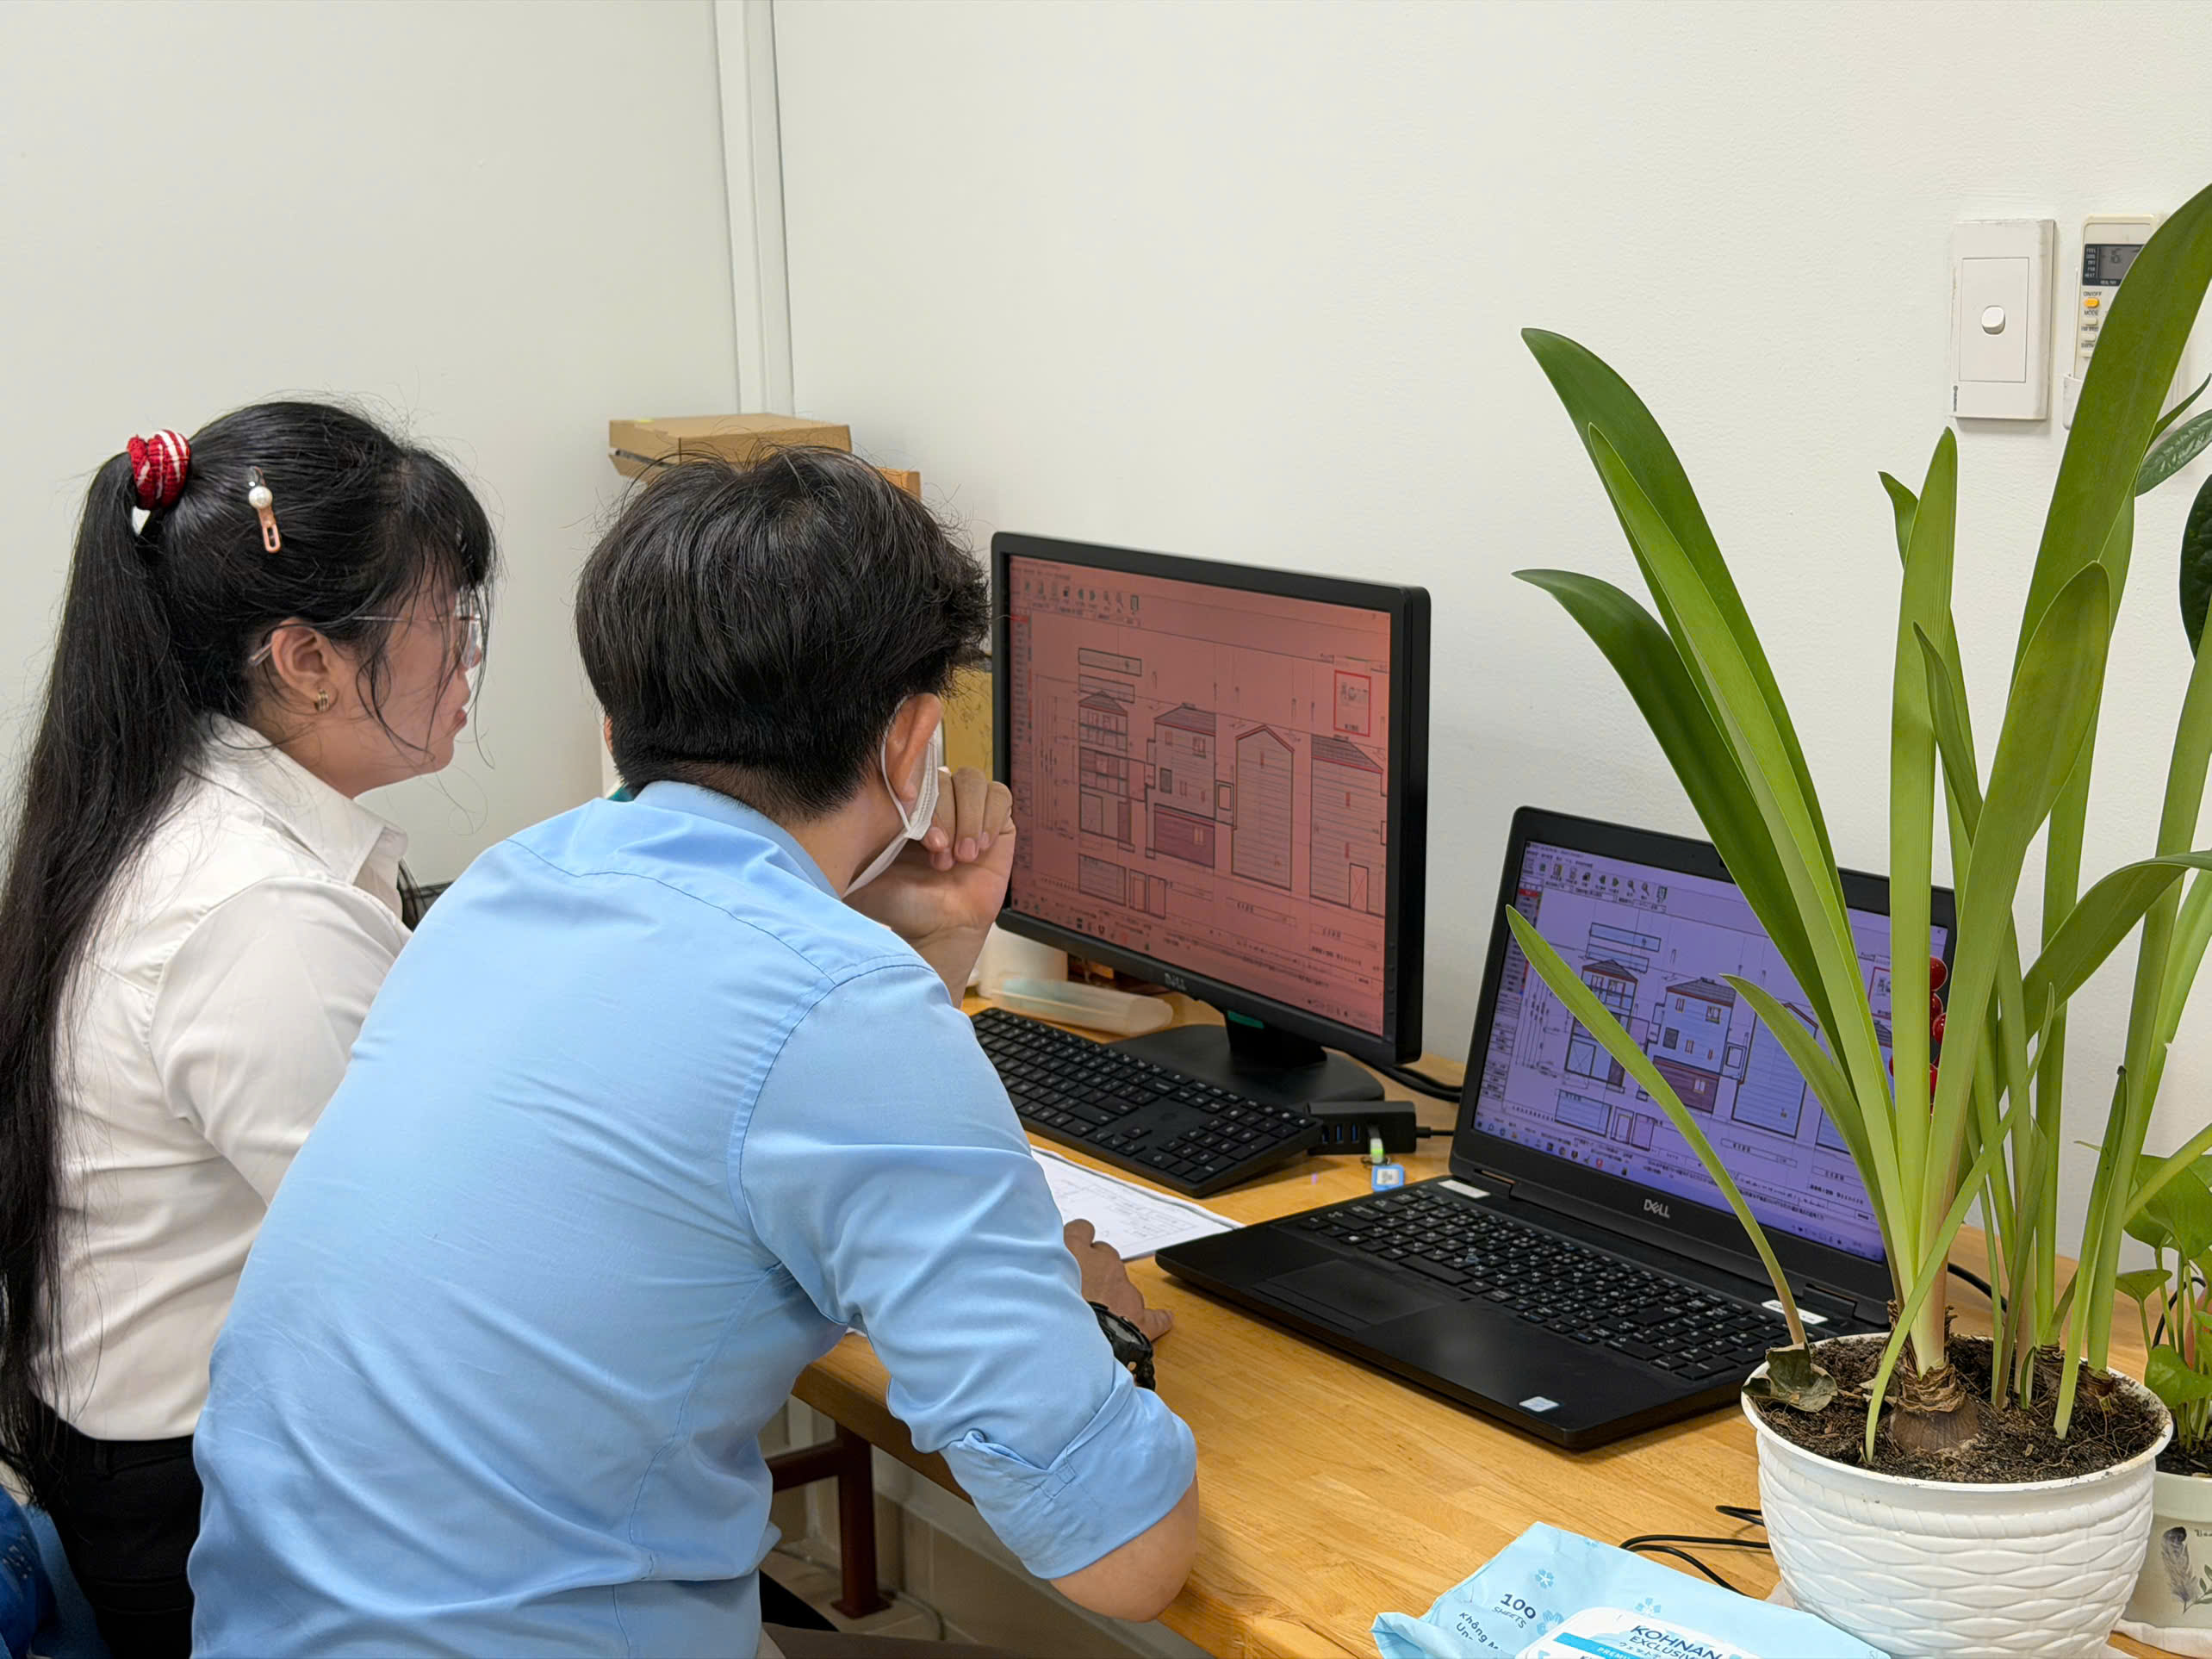
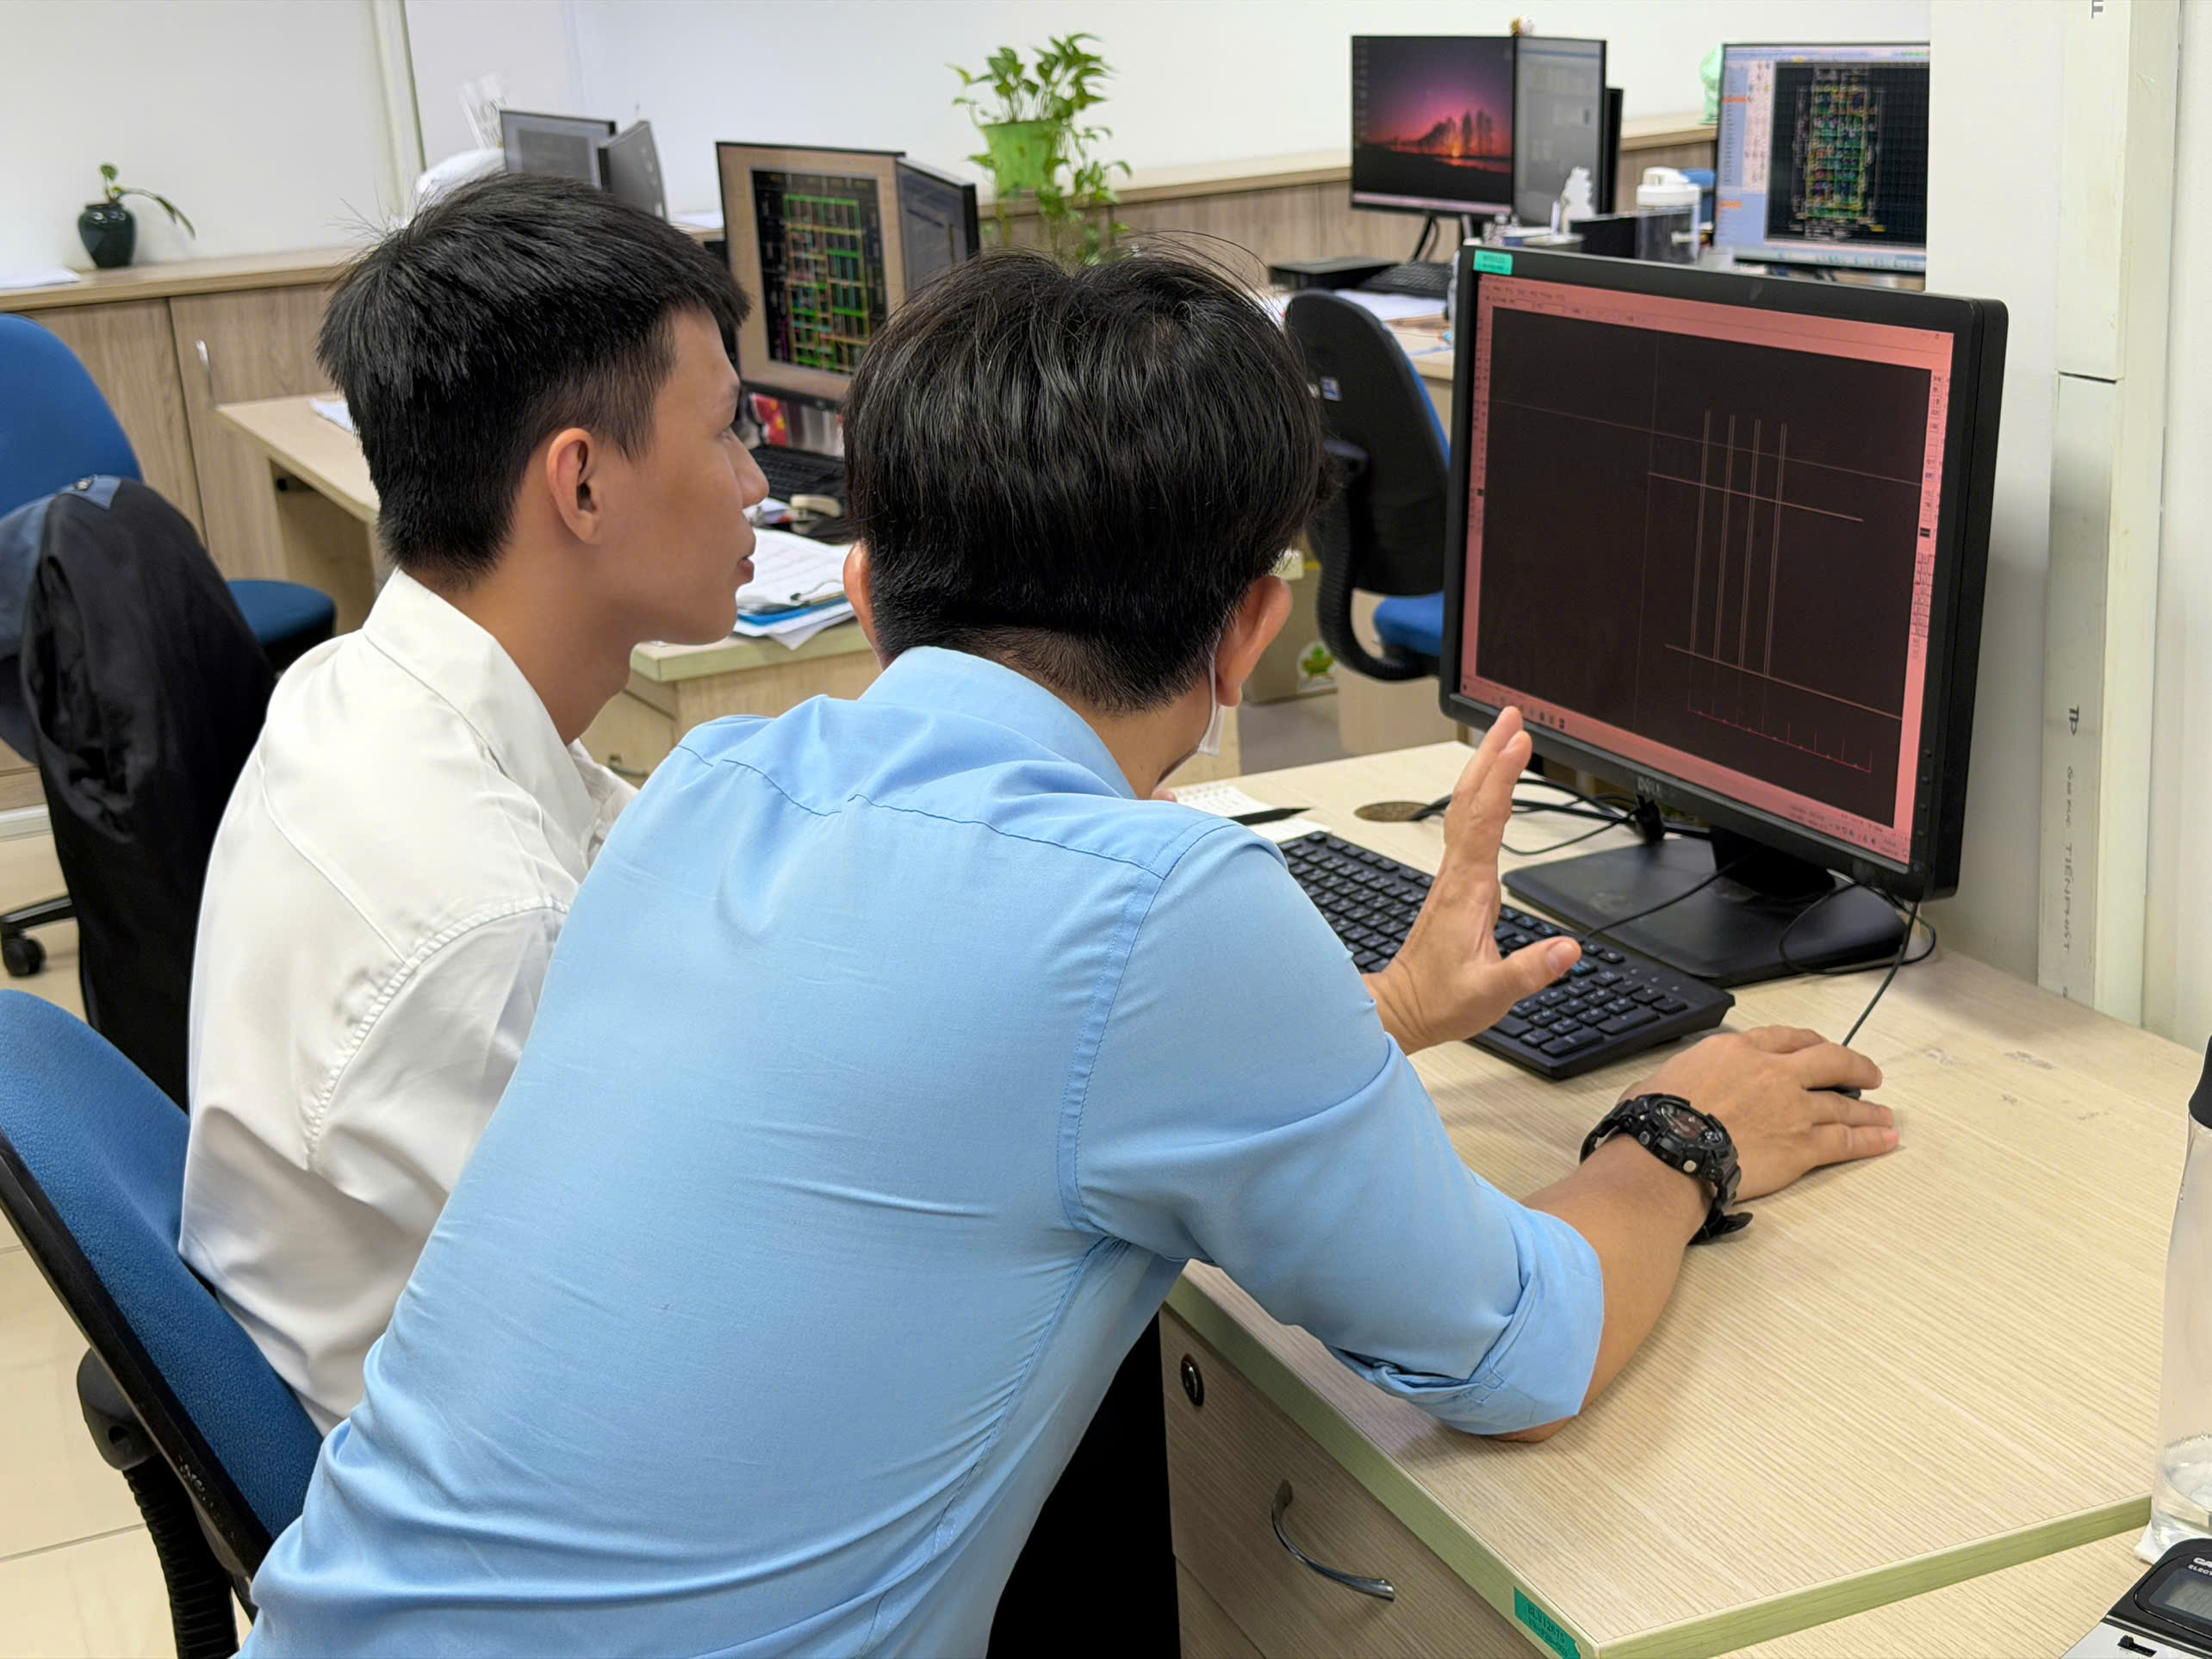
New Employee Training
Employees are trained in drawing interpretation, specialized software usage and
job-specific expertise.
Training typically takes 6–12 months.

Slide 14
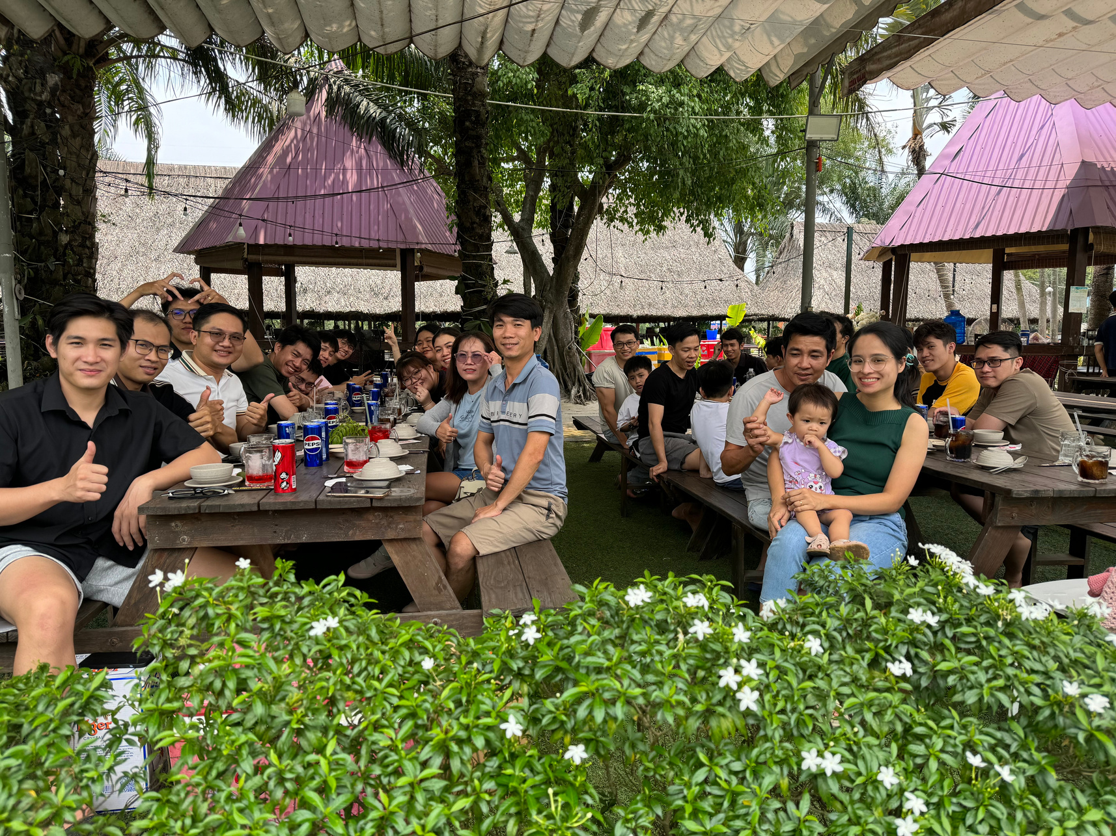
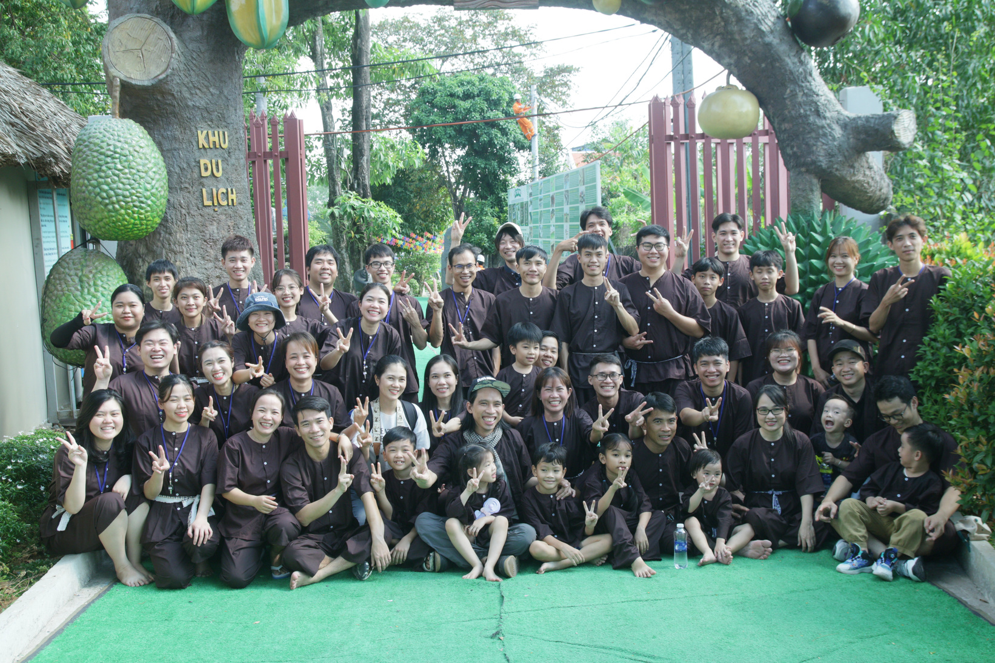
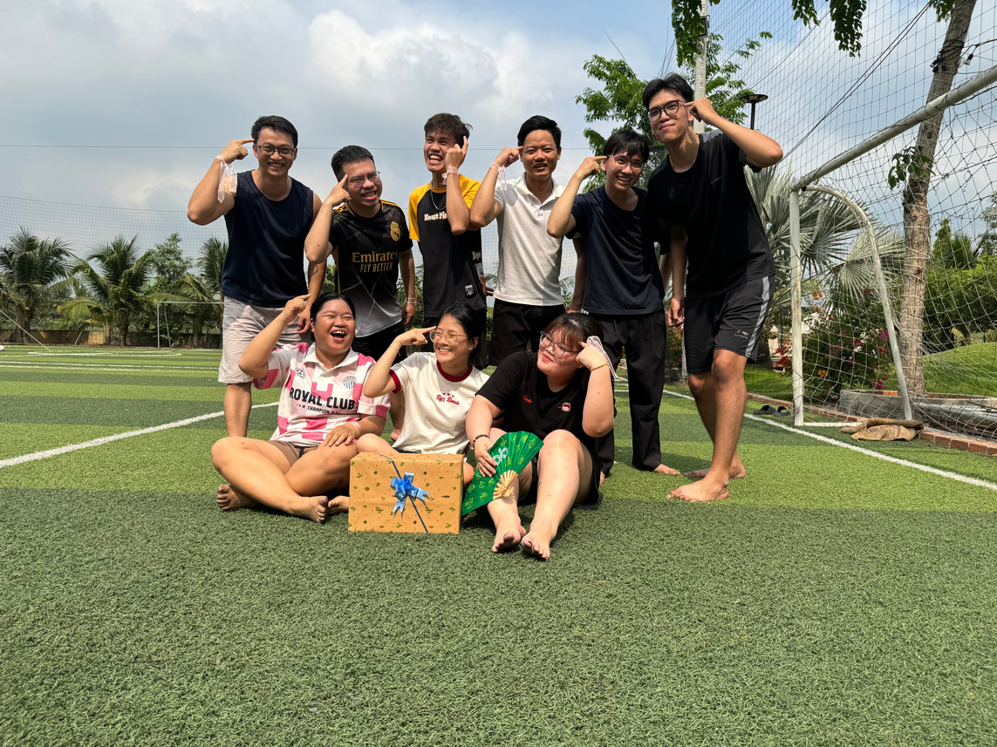
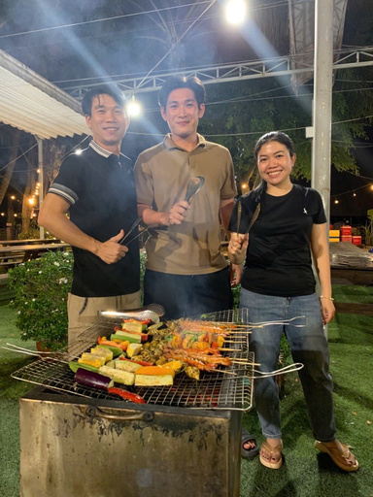
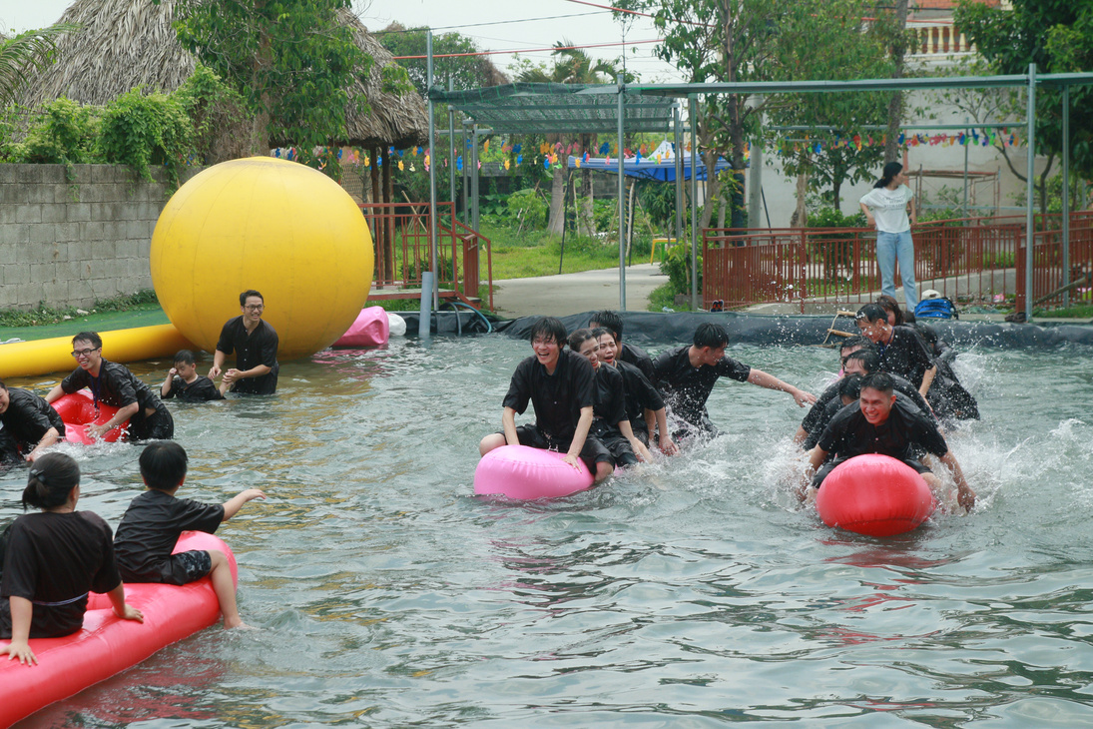
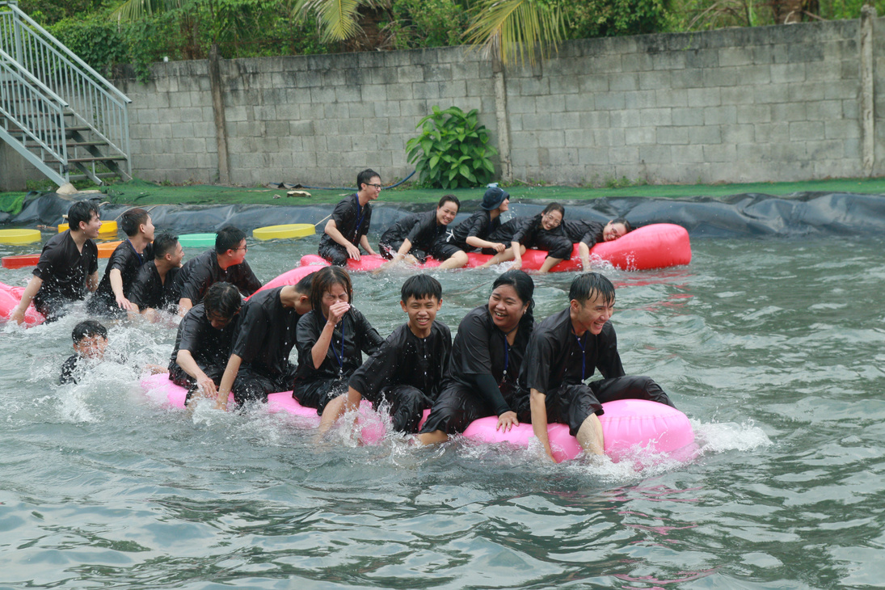

ANNUAL ACTIVITIES
PICNIC • Relaxation • Energy • Bonding
Bonding

Slide 15
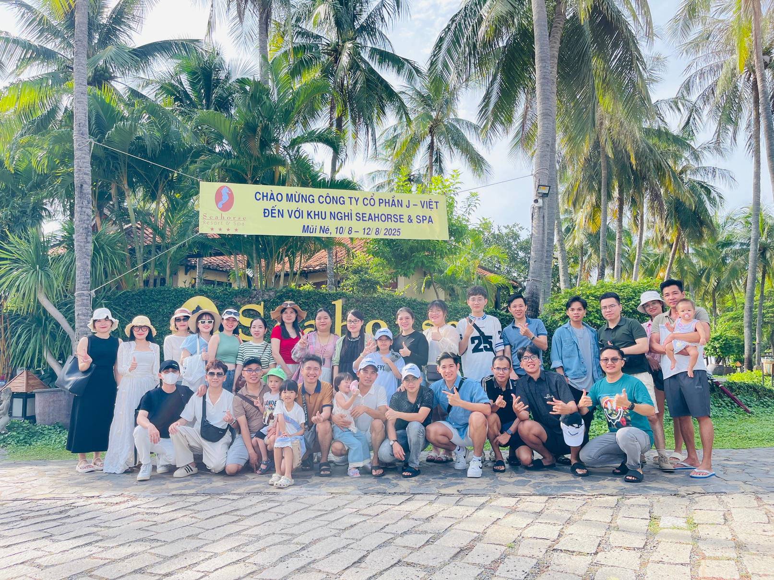
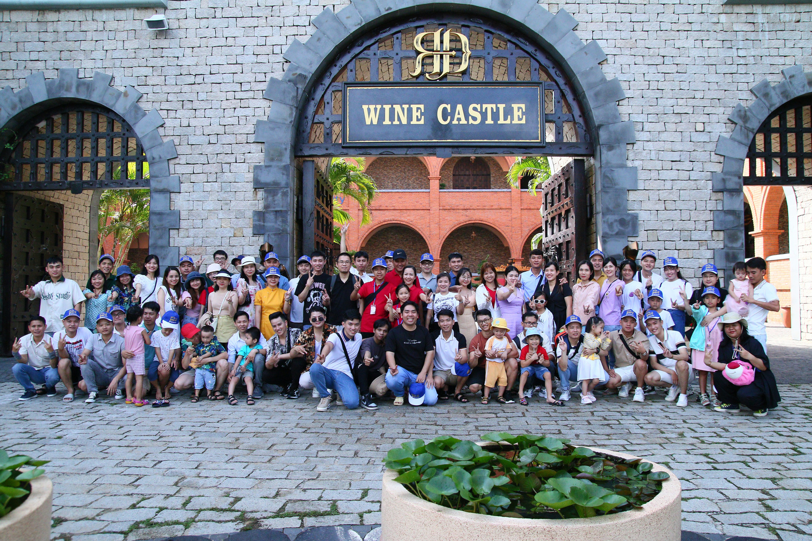
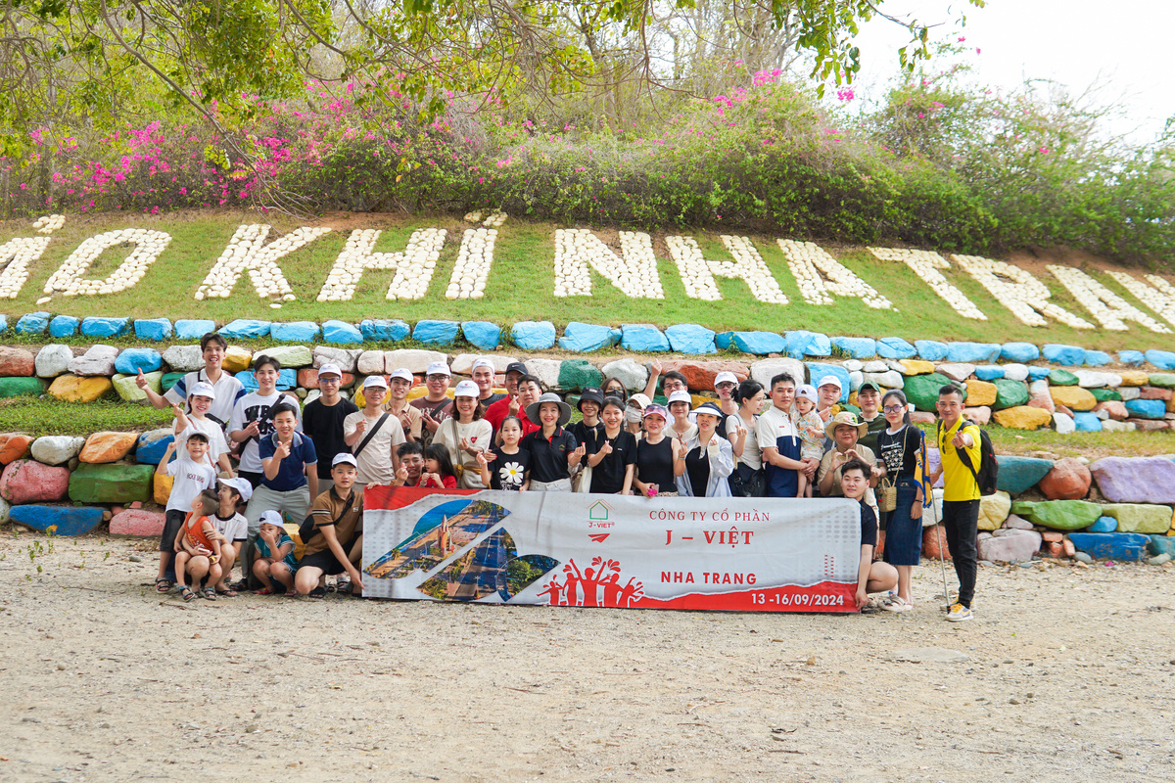

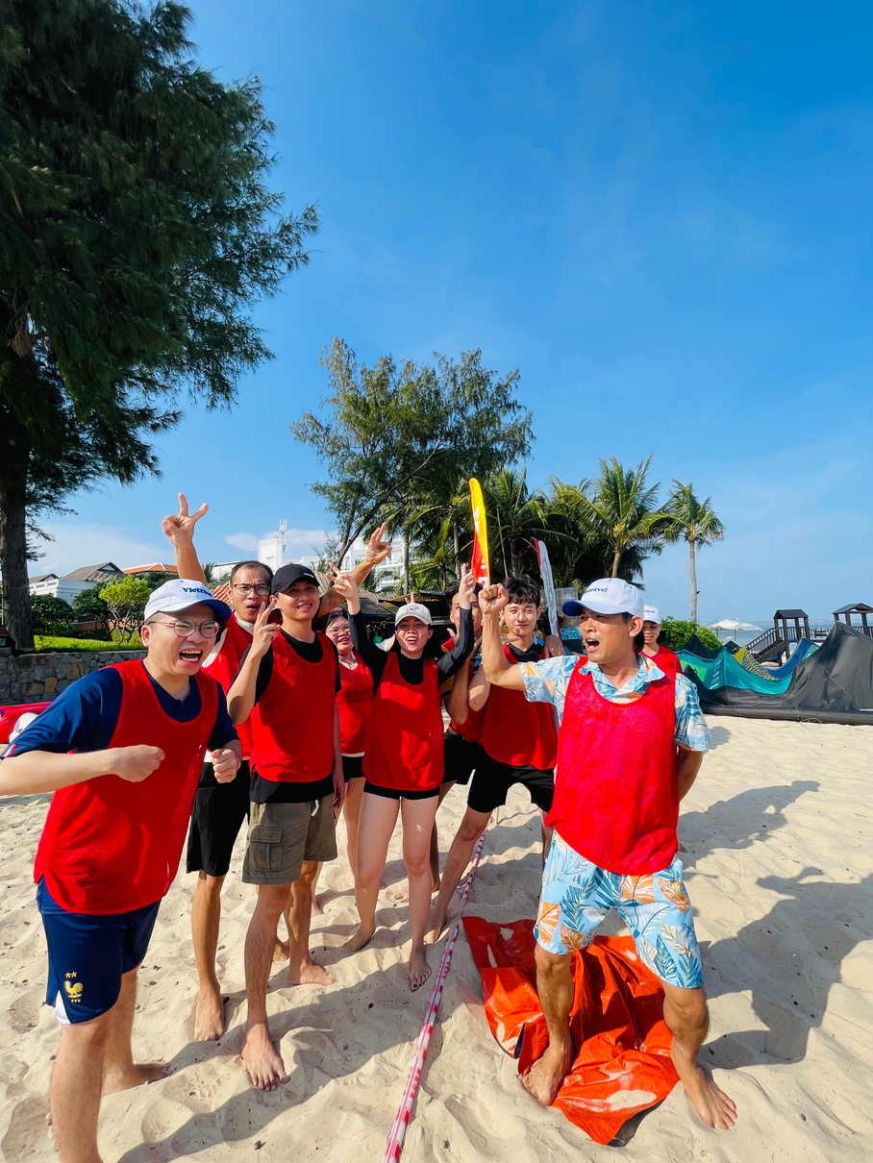
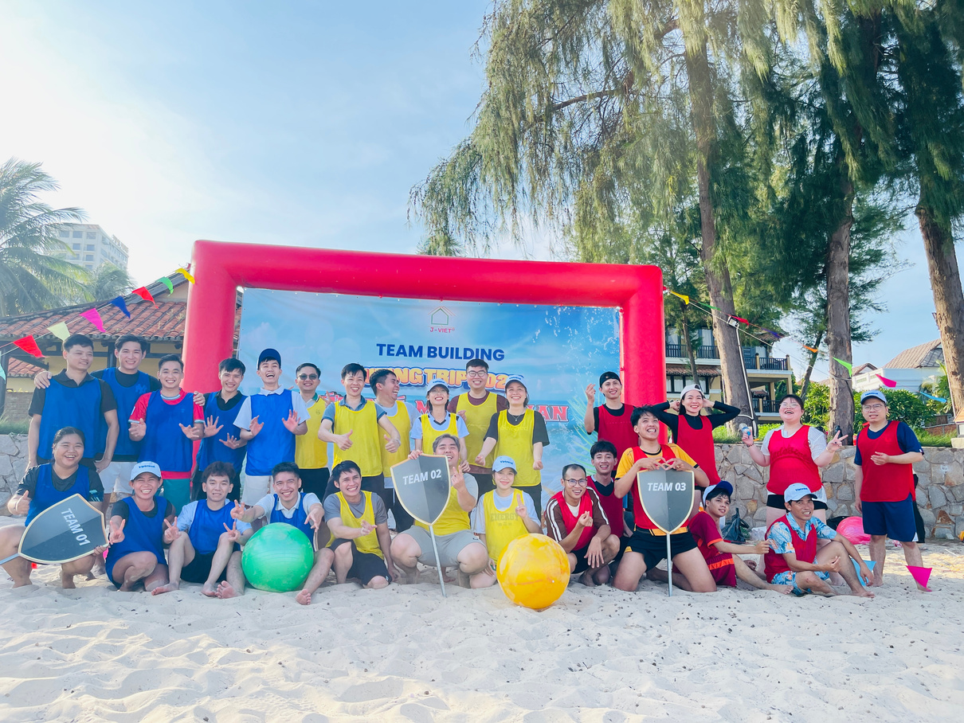
COMPANY TRIP
Let's experience together, let's grow together.

Slide 16
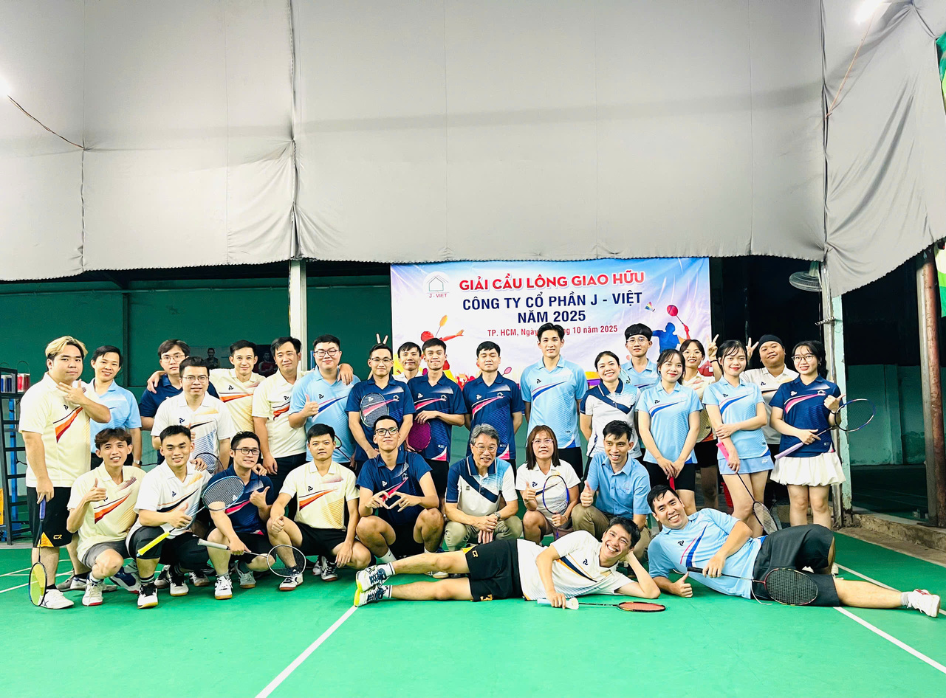
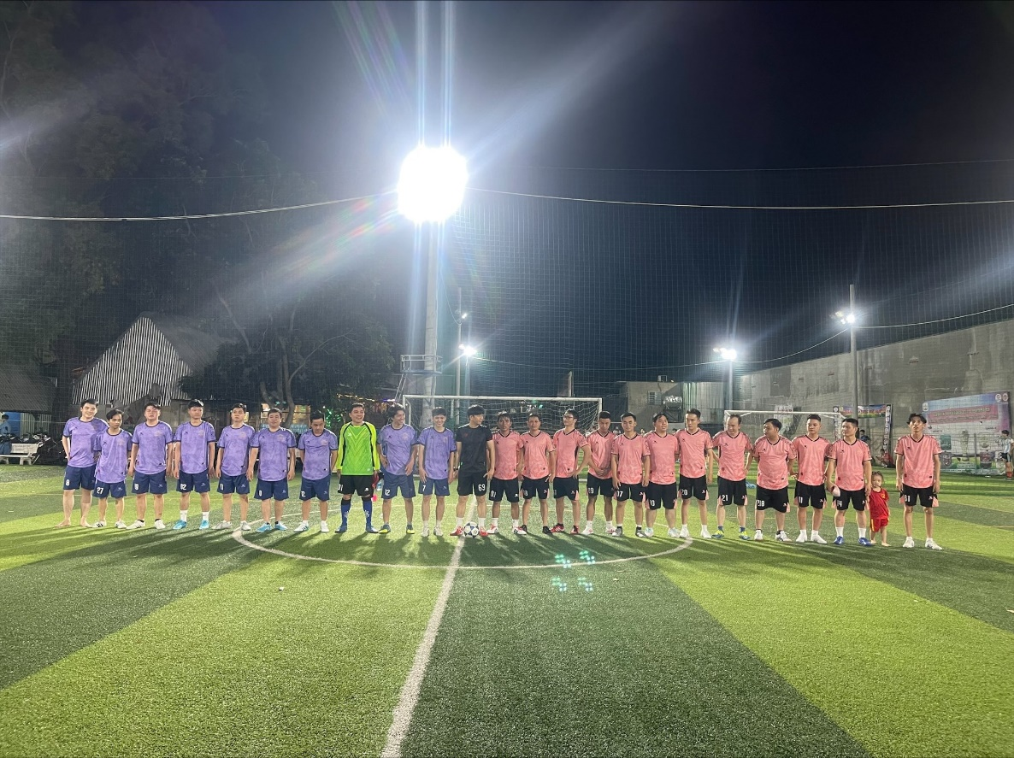
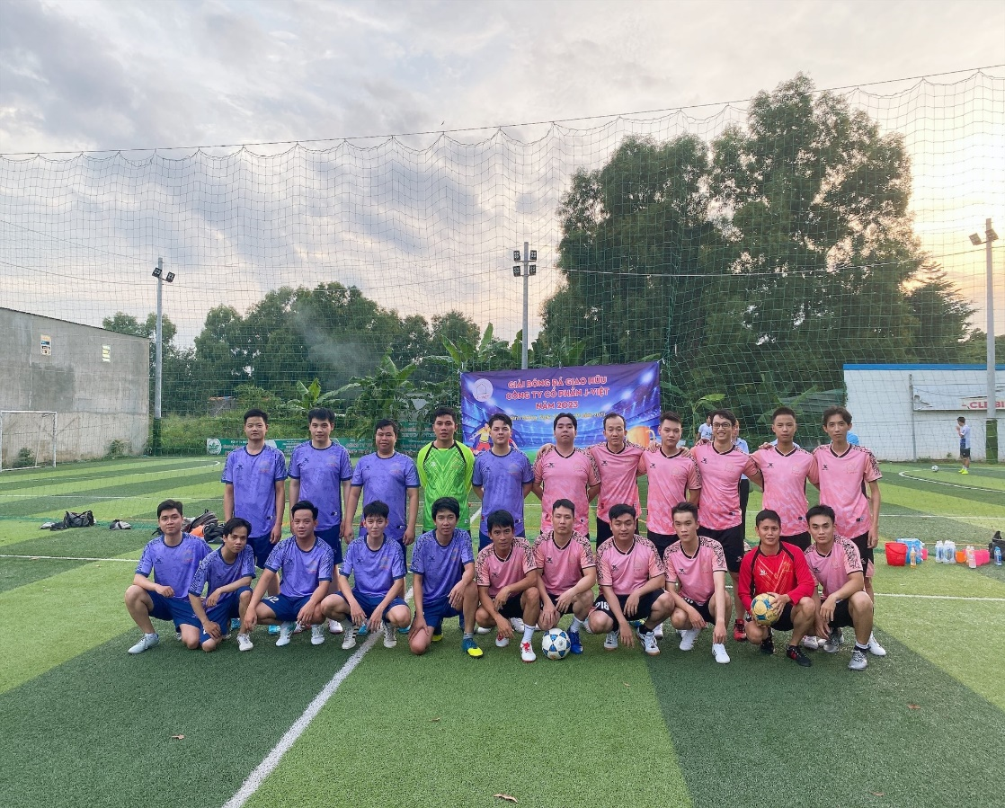
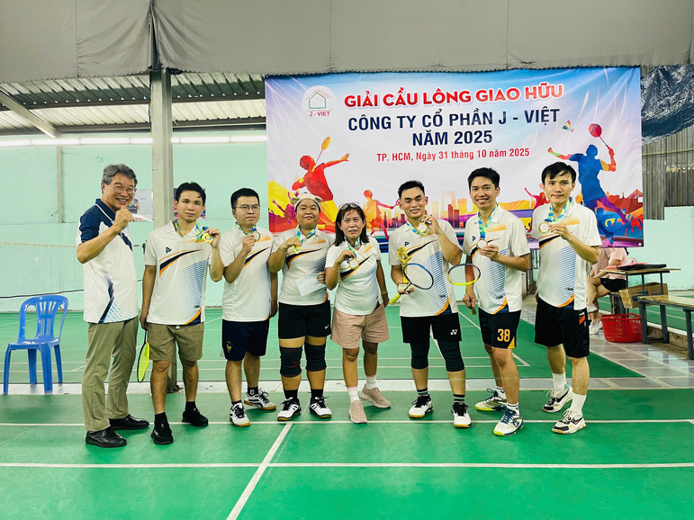
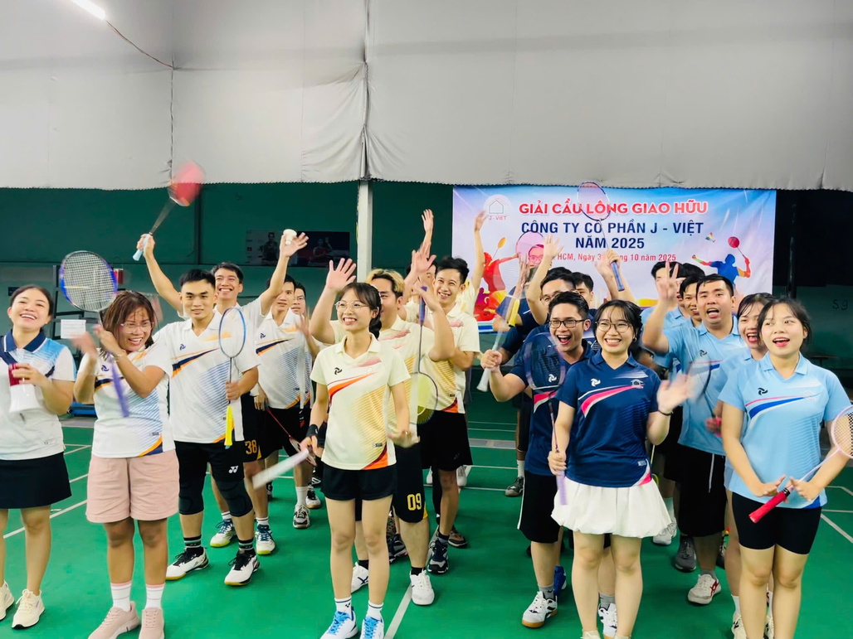
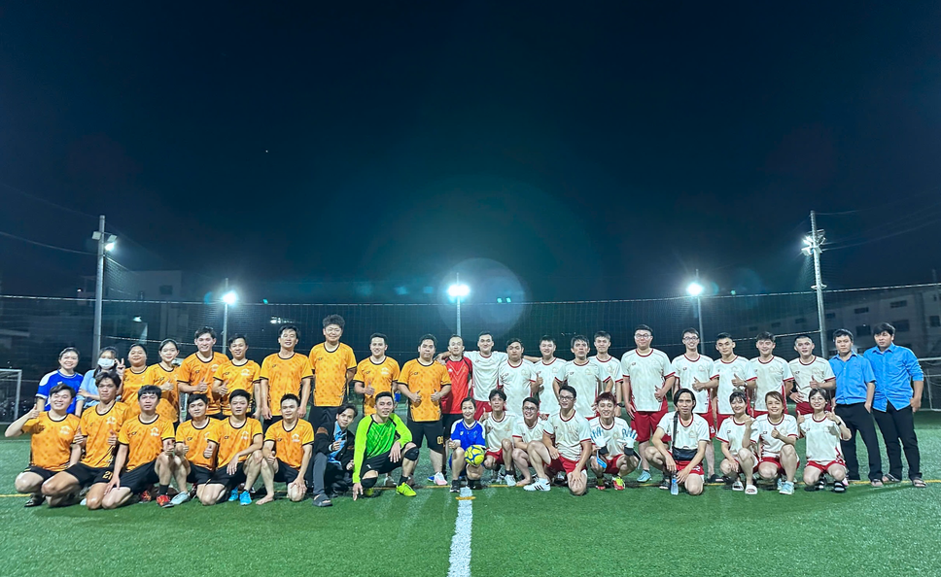

SPORTS DAY
One team, one spirit

Slide 17









BIRTHDAY CELEBRATIONS
Happy birthday to our amazing members!

Slide 18







YEAR AND PARTY
Honoring individuals and teams who have achieved effective and high-quality work results during the year.

Slide 19

WORKING CALENDAR
From April 2026 to March 2027

Slide 20


ありがとうございます。
THANK YOU
Thank you so much for your continued support

